Slide 1


GA Milestones

Slide 2
Testing Schedule
April 13 – May 4, 2016 Georgia Milestones End of Grade (EOG) Spring Administration
End of Grade (EOG) in language arts, mathematics, science and social studies.
Apr 13: ELA Part I/II (Grades 5) Apr 25: Science (Grade 3)
Apr 14: ELA Part III (Grade 5) Apr 26: SS(Grade 3)
Apr 15: Math (Grade 5) Apr 27: Make Up (Grade 3)/ELA Part I/II (Grade 4)
Apr 18: Science (Grade 5) April 28: ELA Part III (Grades 4)
Apr 19: SS (Grade 5) April 29: Math (Grade 4)
Apr 20: Make Up (Grade 5)/ELA Part I/II (Grade 3) May 2: Science (Grade 4)
Apr 21: ELA Part III (Grades 3) May 3: SS(Grade 4)
Apr 22: Math (Grade 3) May 4: Make Up (Grade 4)
May 23 – May 26, 2016 Georgia Milestones End of Grade (EOG) Retest
End of Grade (EOG) in language arts, mathematics for Grades 3, 5 and 8 ONLY
May 23: ELA (Part I/III) (Grades 3, 5 & 8)
May 24: ELA (Part III) (Grades 3, 5 & 8)
May 25: Math (Grades 5 & 8)
May 26: Make – Up (Grades 3, 5 & 8)

Slide 3
Overview
Each assessment will consist of two 70 – 80 minute sessions except for ELA session 3 which consist of 90 minutes
Students with daily accommodations through SWD, EL, or Section 504 will receive the same accommodations for the assessment
Students who have a “read to” accommodation will take each assessment online
Student class size maximum will be 29 or smaller unless there is a test administrator and test proctor in the room
Students may review at home by accessing GoFAR.
Teachers will systematically begin GA Milestones review starting March 23rd
  ELA and Mathematics will have a mock test environment using sample score sheets March 30th – April 2nd

Slide 4


Slide 5
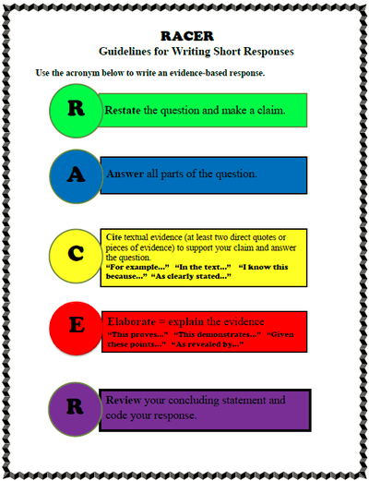

Slide 7
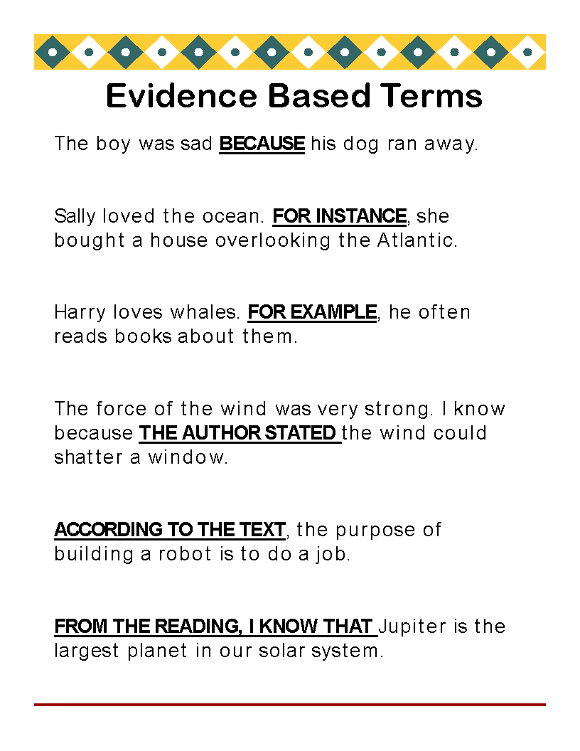

Slide 8
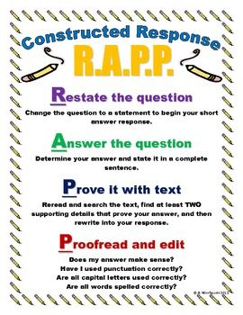

Slide 9
Welcome to Experience Online Testing Georgia!
Welcome to Experience Online Testing Georgia!
The Georgia Milestones tests measure what students in grades 3 through high school have learned. Many students will take the new tests online.
This practice site lets students see what testing online is like. Parents and educators are welcome to try it, too. The items on the demonstration tests are general and are organized into three grade bands: Grades 3 – 5, Grades 6 – 8, and High School in the content areas of English Language Arts, Mathematics, Science, and Social Studies. The items do not necessarily represent the specific grade-level content that students learn daily in their classrooms. The primary purpose is to let students experience, firsthand, the functionality of the online testing platform. The sample tests are not graded, so have fun!
Select from the list below to begin your Experience!
Grades 3-5
Grades 3-5 Test Practice
http://learnoas.ctb.com/GA/
www.engageny.org

Slide 10

Ask you to apply your knowledge and understanding in a short written answer.
On standardized tests, these short written answers are scored as 0,1,2,3, or 4 points.
A full 4 point response answers all 4 parts of the question, usually two, two-part questions.

Slide 11

Remember:
Never leave the answer on the constructed response questions blank; this will get zero points!
Always attempt to answer the question.
Every part of a correct answer equals 1 point. Try to answer all four parts.
Good luck!

Slide 12
ELA
Content Weights
  Reading & Vocabulary 53%
  Writing & Language 47%
Three Types of Assessment
  Selected Response (Multiple Choice)
  Constructed Response (Short Answer)
  Extended Response (Essay)
60 Total Questions
  44 Criterion-Referenced
    40 Selected Response (1 point each)
    2 Constructed Response (2 points each)
    1 Constructed Response (4 points)
    1 Extended Response (7 points) Section 3
  20 Norm-Referenced
    10 of which are counted in CR total
  6 Embedded Field Test

Slide 13
ELA
All students will encounter a constructed –response item allowing for narrative prose, in response to text, within the first or second section of the test.
Within the writing section of the test, students will read a pair of passages:
  3 selected-response items require comparing/contrasting between the two passages
  1 constructed-response item requires linking the two passages
  1 writing prompt in which students must cite evidence to support their conclusions, claims, etc. (Section 3)
    Writing prompts will be informative/explanatory or opinion/argumentative depending on the grade level. Students could encounter either genre.
Answer Document Example (Open Hyperlink)
  http://www.gadoe.org/Curriculum-Instruction-and-Assessment/Assessment/Pages/Georgia-Milestones-EOG-Resources.aspx

Slide 14
ELA Prep
Reading and analyzing literary and informational text
  Citing text evidence in oral and written responses
  Demonstrating comprehension of text
  Acquiring and using vocabulary
Writing skills for constructed and extended response
  Argumentative
  Informational (Expository)
  Narrative
  Analyzing a Prompt
Assessment simulation
Online Resources
  www.engageny.org
  PARCC Assessment Practice Test

Slide 15


Slide 16
MATH
GRADES 3-5
Three Types of Assessment
  Selected Response (Multiple Choice)
  Constructed Response (Short Answer)
    Students constructs response on their own
    Worth two points; partial credit awarded
  Extended Response (Essay)
    Detailed constructed response
    Will have multiple parts
    Worth four points; partial credit awarded

Slide 17
Example of Math
Constructed Response

Slide 18
Science
75 Selected Response items
Given in two sections
70 minutes per section
Depth of Knowledge Levels 1-3

Slide 19
Social Studies
Grades 3-5
75 Questions
2 Sections
Up to 70 Minutes per Section
Multiple Choice Questions
Incorrect Responses are Written as Distractors
3 Depth of Knowledge Levels
  Identify Places on a Map
  How/Why Questions
  Read the Chart/Graph & Make Inferences

Slide 20
What Can We Do at Home to Prepare?
Visit Websites for Online Resources:
  Georgia Online Assessment System
  Overview & Blueprints of the Assessments with Sample Test Questions
Test Taking Strategies
  Get a Good Night’s Sleep
  Arrive to School on Time
  Eat a Good Breakfast
  Encourage Each Other !
  http://kidshealth.org/kid/feeling/school/studying.html?tracking=K_RelatedArticle#cat20869
  http://kidshealth.org/kid/feeling/school/test_anxiety.html?tracking=K_RelatedArticle

